Slide 1
DAT259 Presentation by Tore Wie Bøe

Slide 2
Project overview
Implementing a chosen data flow analysis
Main requirements:
Datatype representing WHILE language program (as input) ✓
General superclass for implementing a given Data Flow Analysis ✓
Implementation of chosen analysis (Reaching Definitions) ✓
Additional (working) implementation of Available Expressions, with program analysis pipeline ✓
Test case pipeline for arbitrary list of programs ✓

Slide 3

The implementation

Slide 4
Structure of program datatype
WHILE program syntax for applying analysis onto ✓
Tree structure allowed to parse recursively ✓
Two main parts: Expression and Statement
Statement as the higher level, down to Expressions, then further down to
variables and constants (base cases)

Slide 5
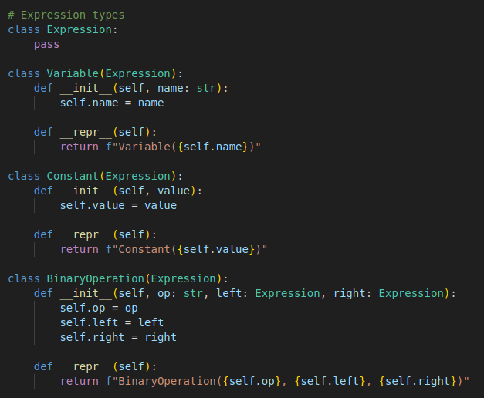
Expression part
Expression:
Variable, constant and binary
operation ✓
Each part of the structure a
separate class ✓

Slide 6
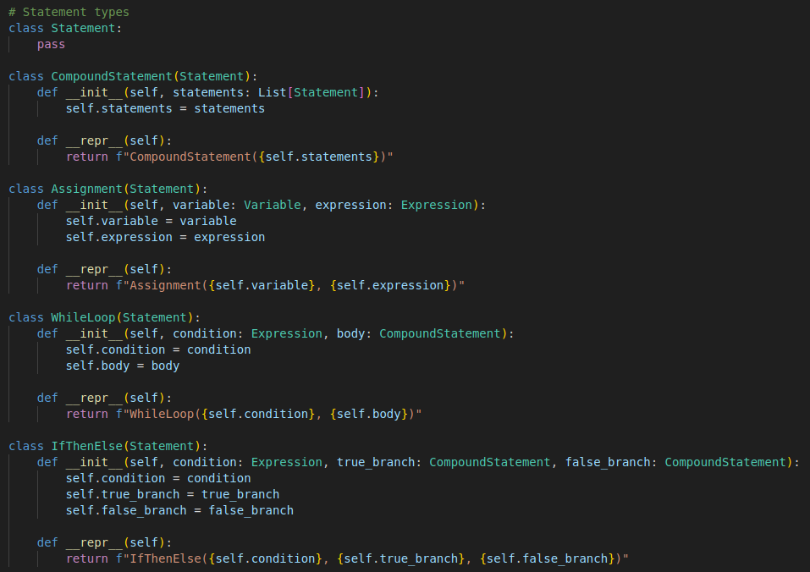
Statement part
Statement:
Every program being a
CompoundStatement
which consists
of other CompoundStatements
and/or as lower level structures,
that can be iterated on
recursively

Slide 7
Example programs
Language to work with: the WHILE language (expressed with
this structure)
Four example programs of varying degrees of complexity, to be used with the analysis implementation
Also added a specific book example in order to check that the output of the program matched the results in the book

Slide 8
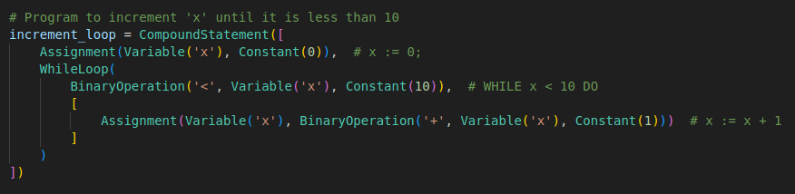
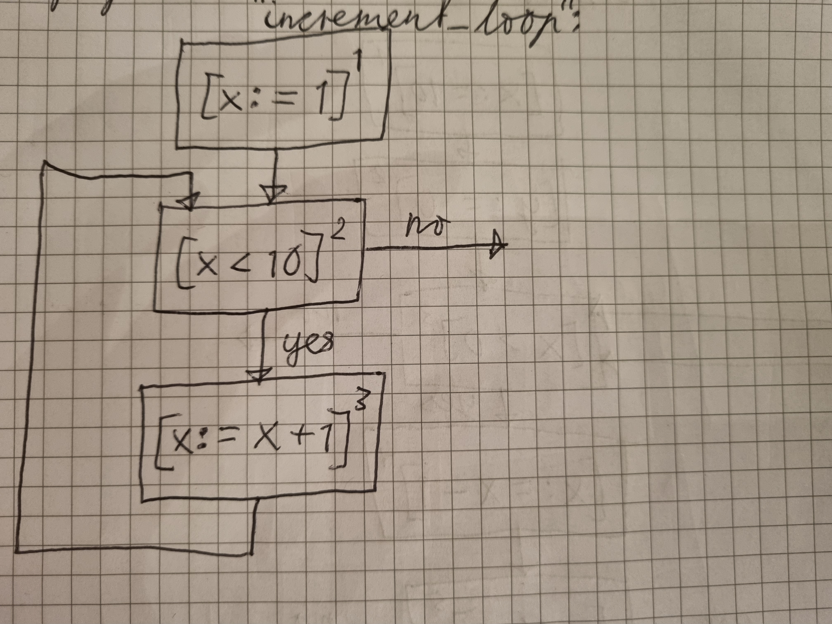
Program example

Slide 9
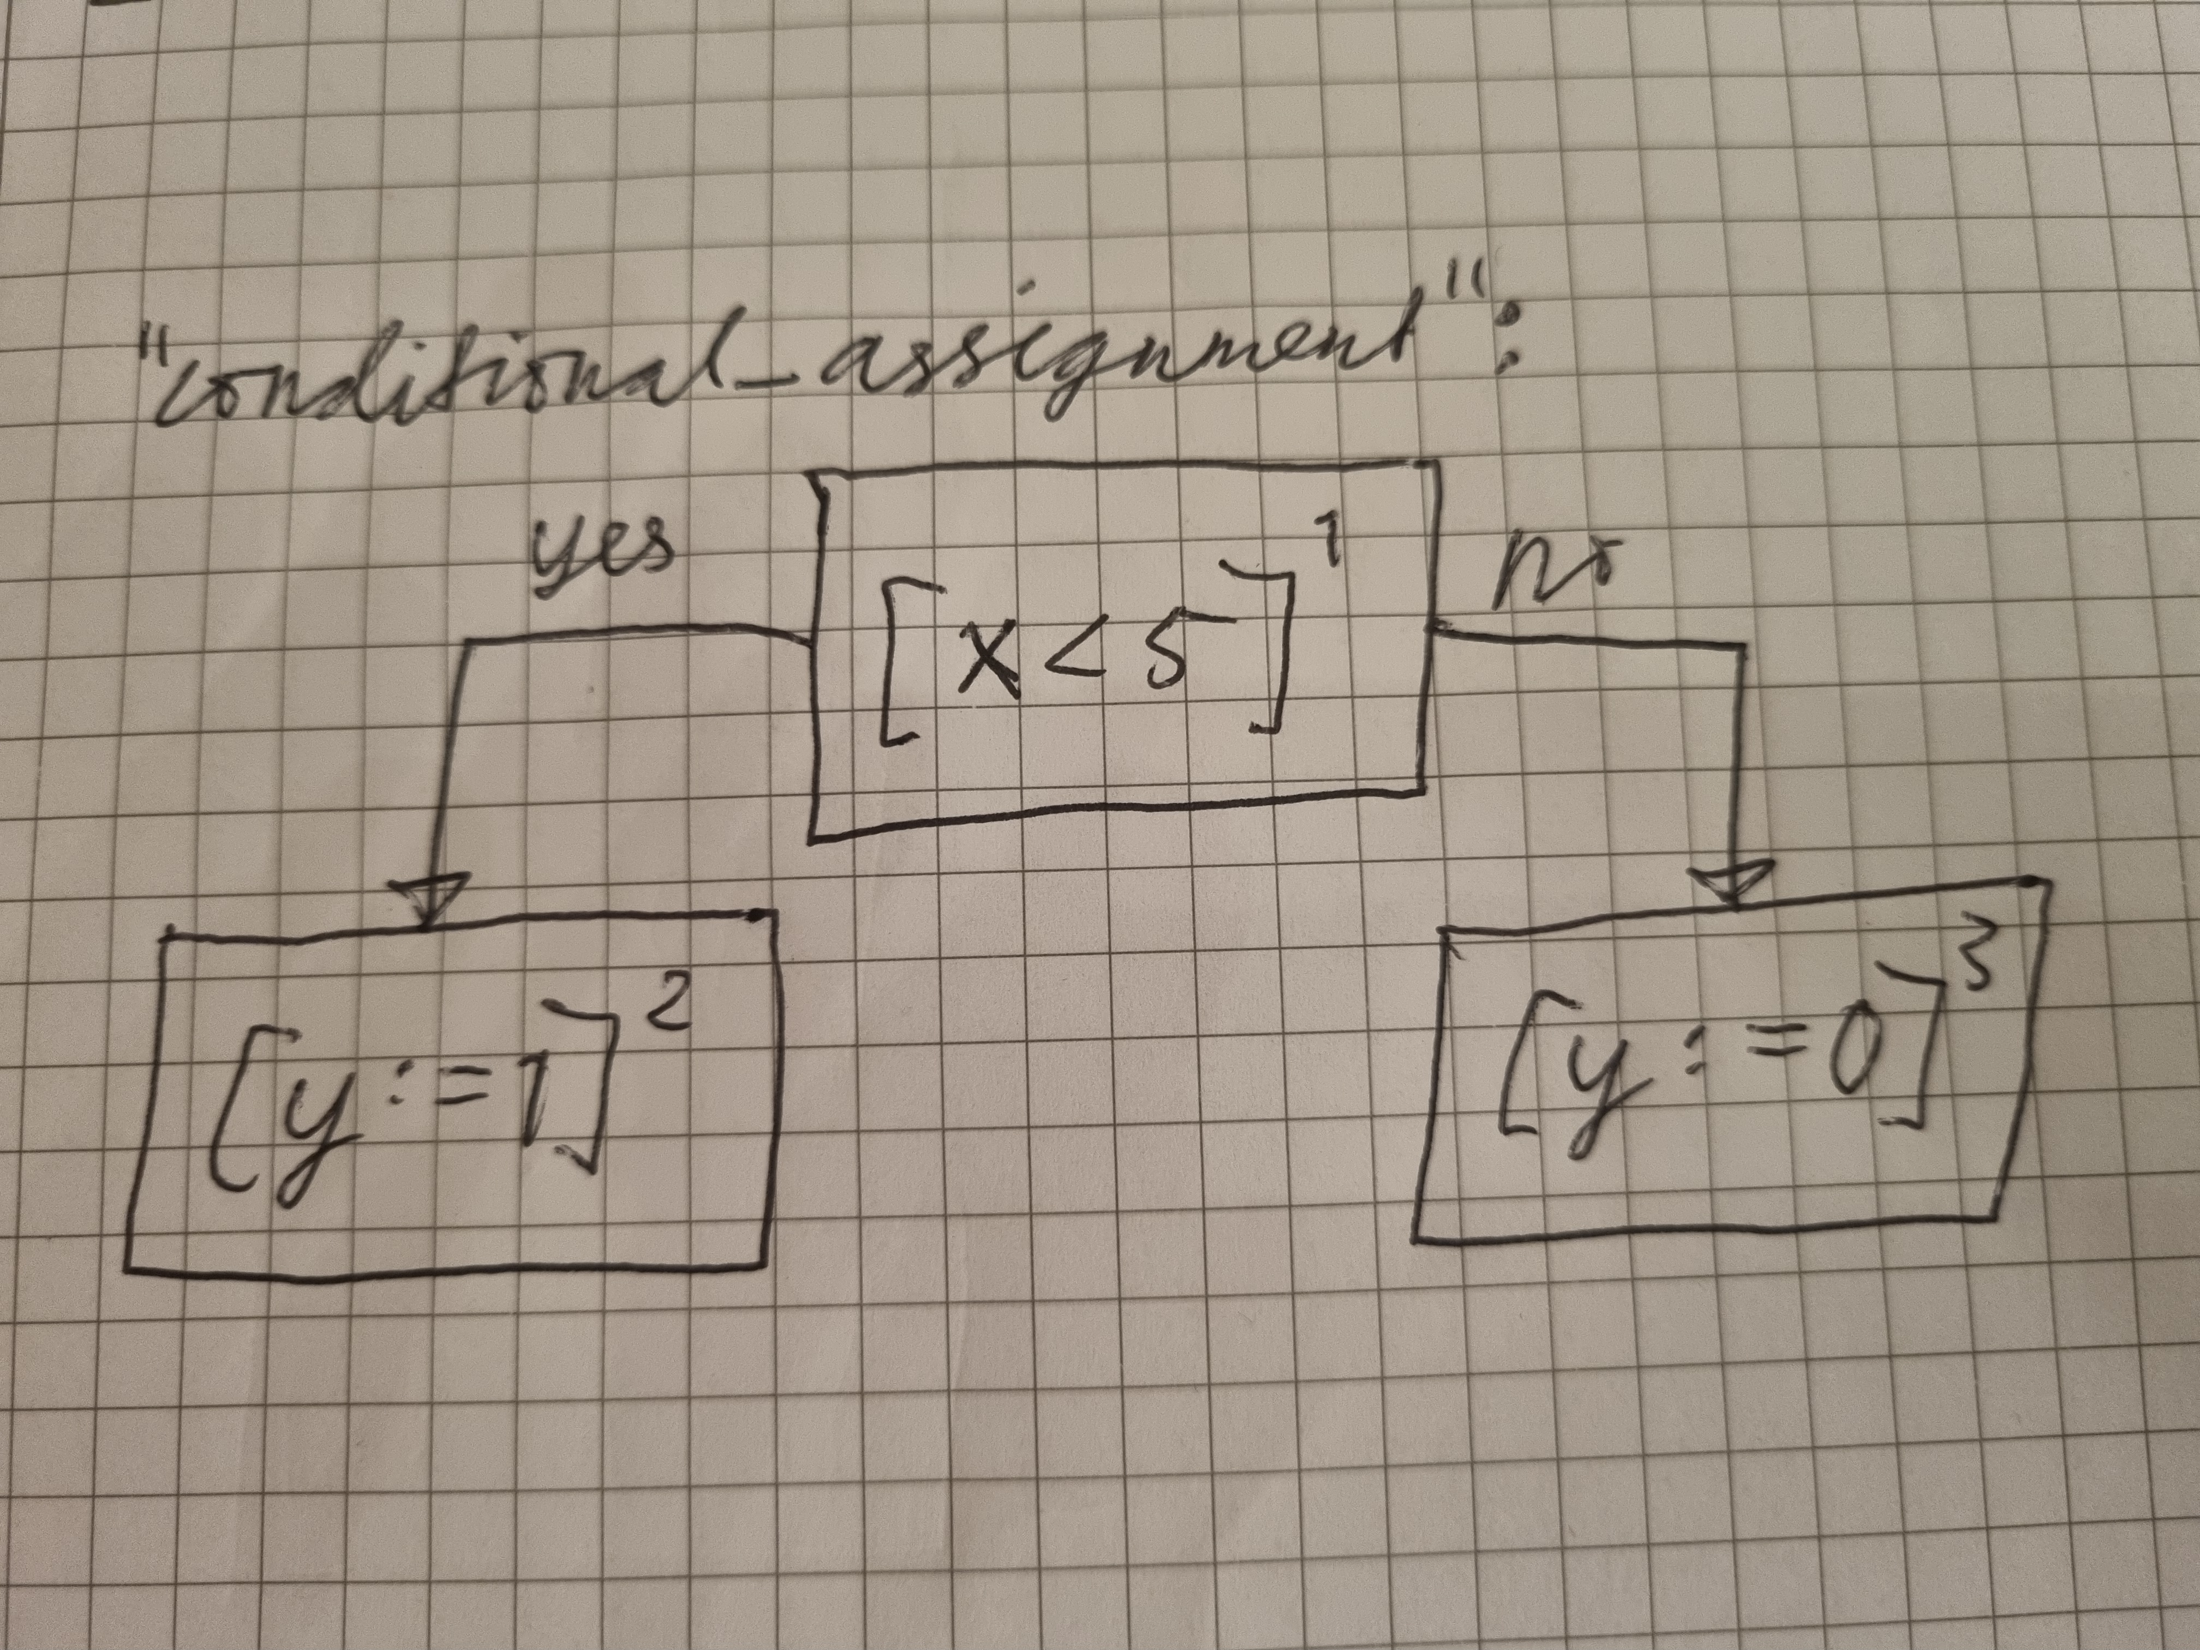
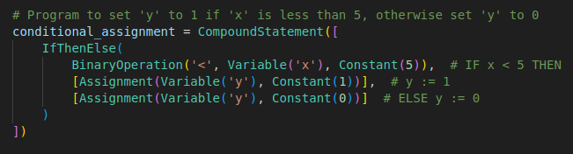
Program example

Slide 10
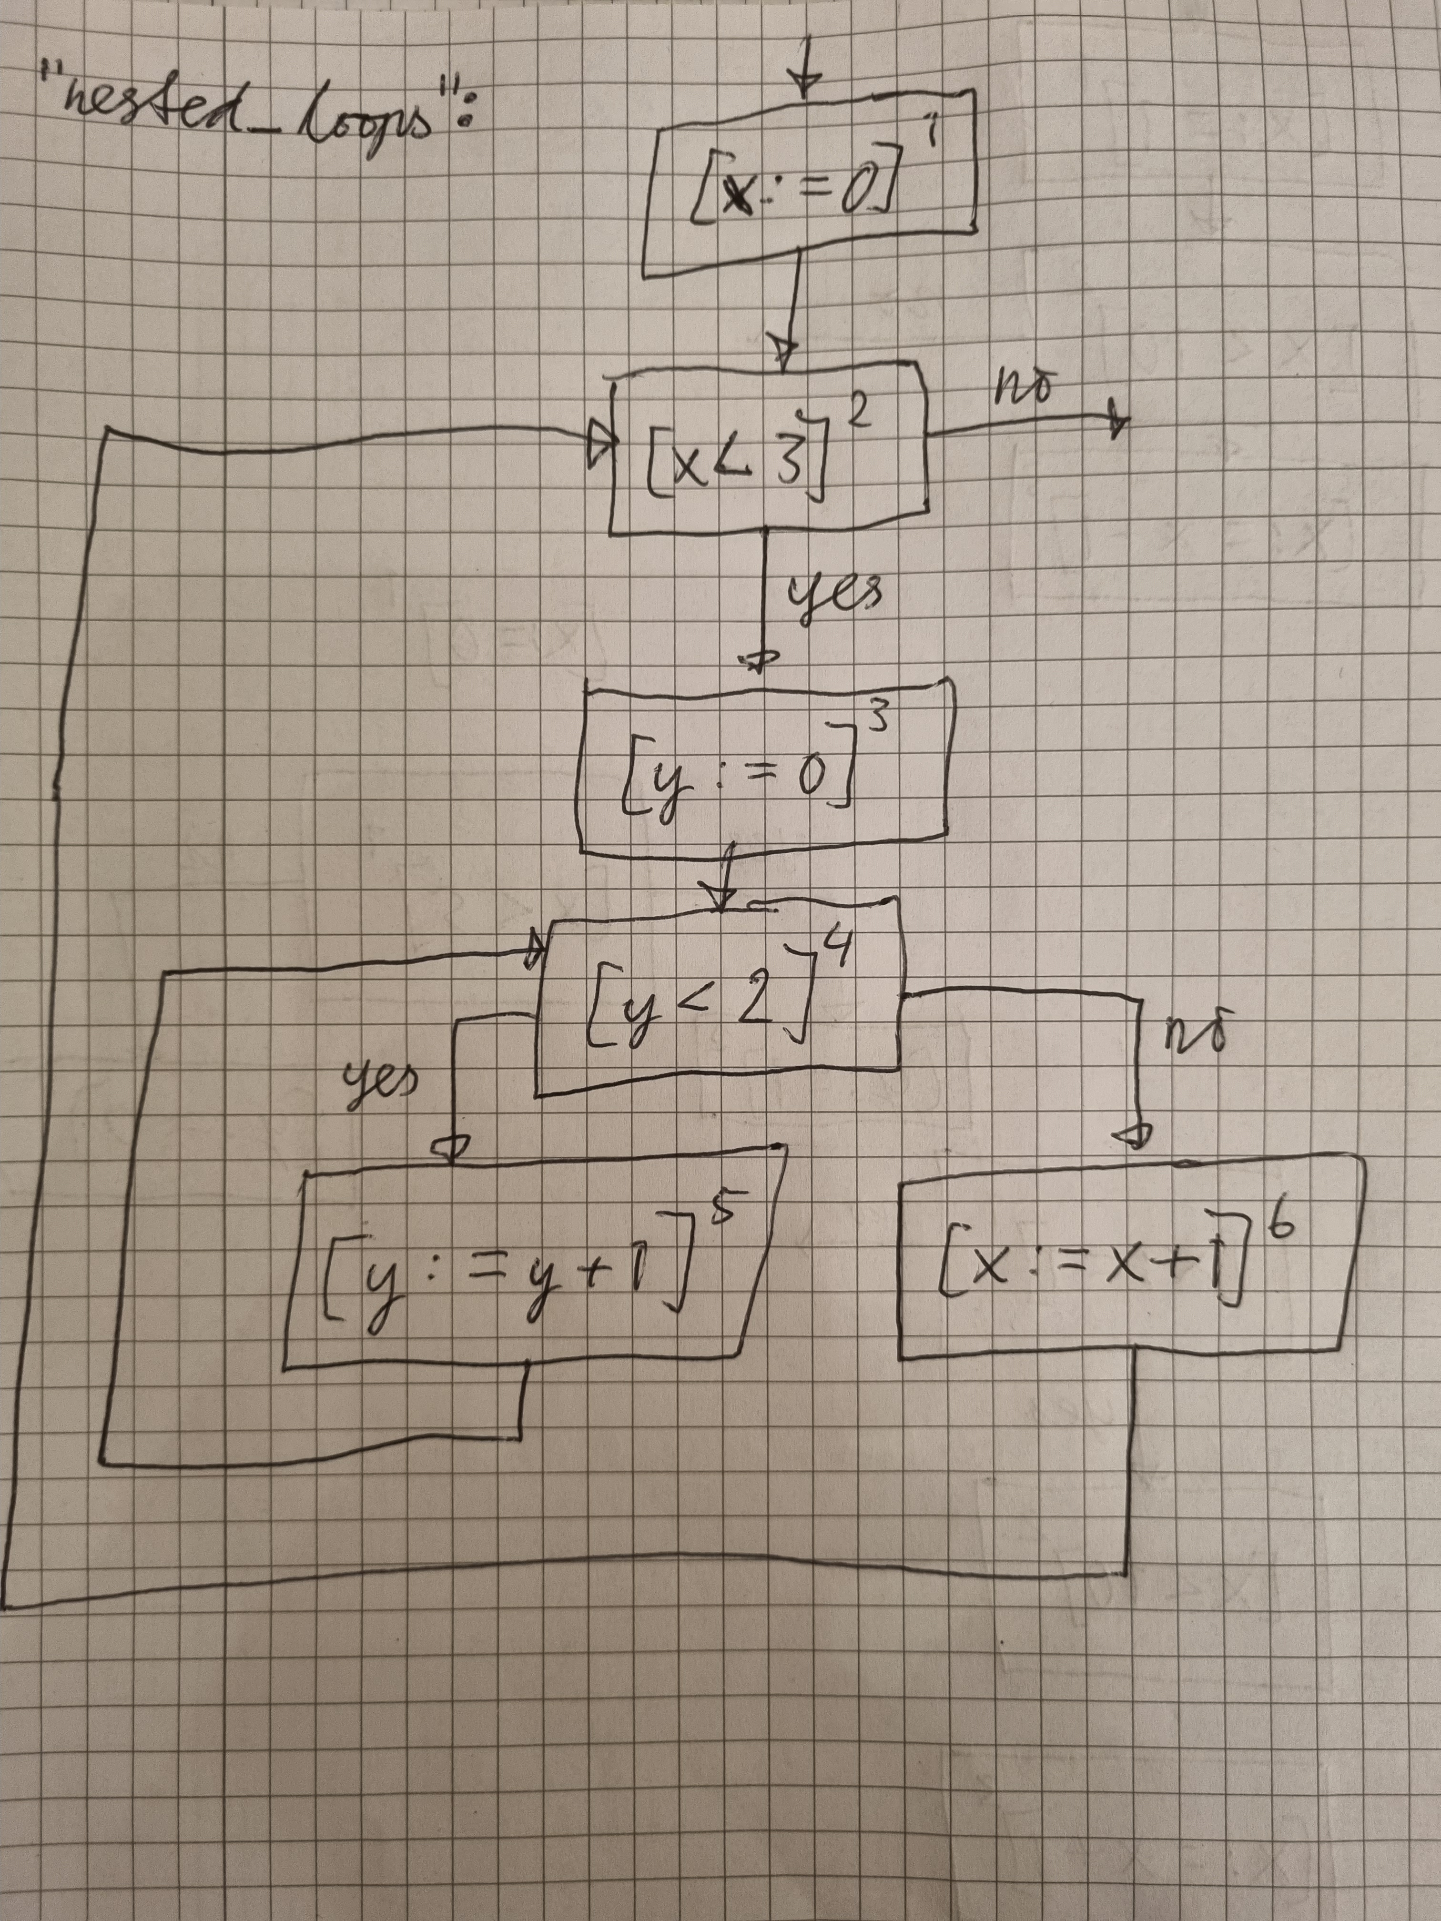
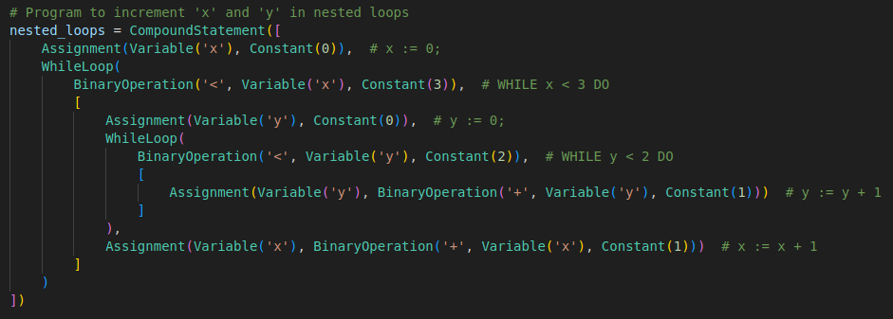
Program example

Slide 11
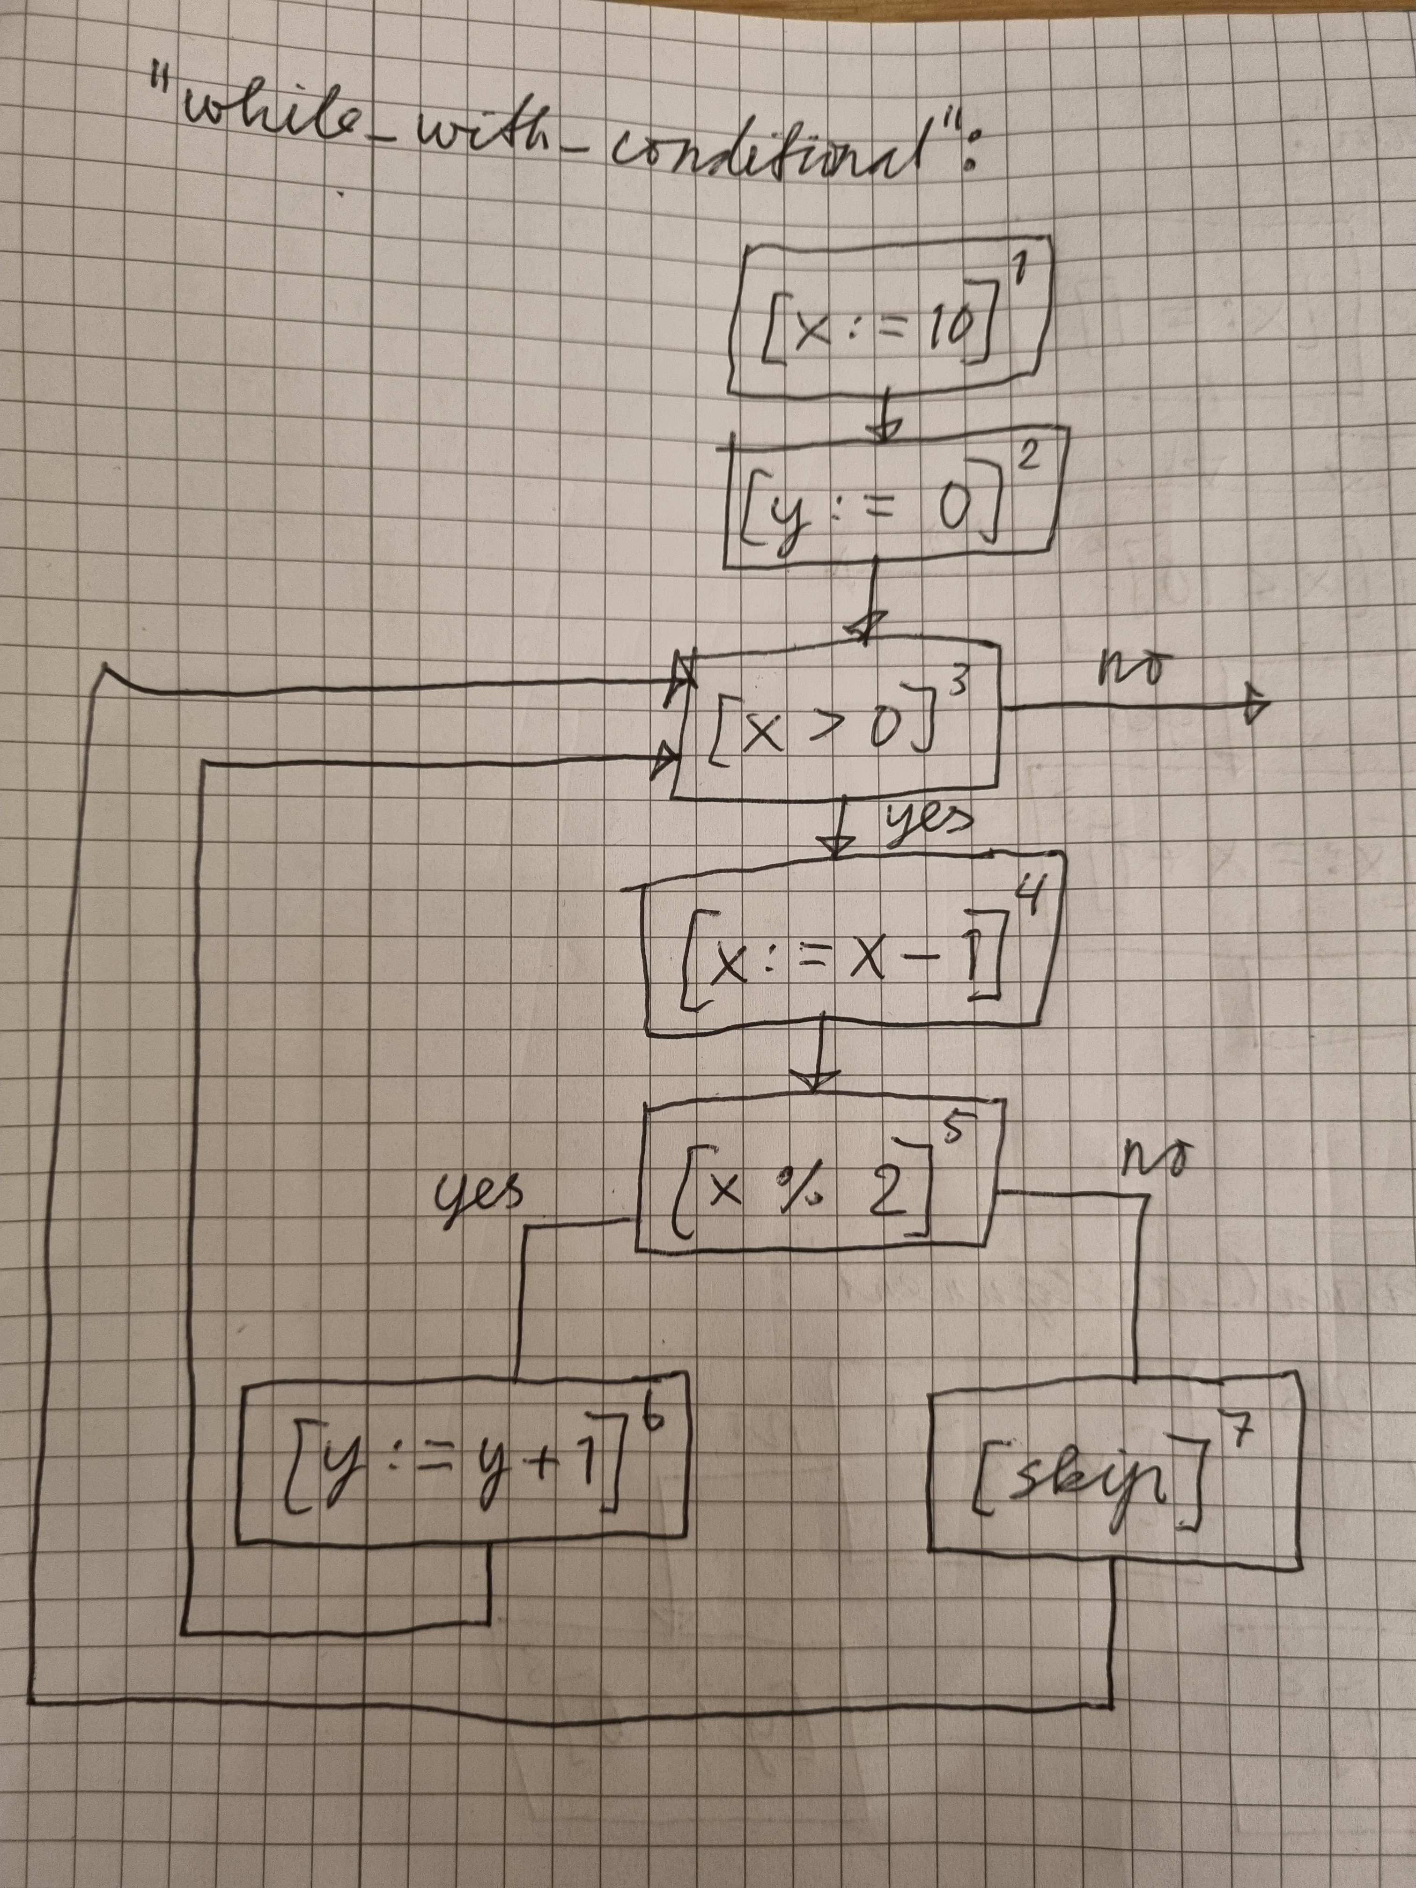
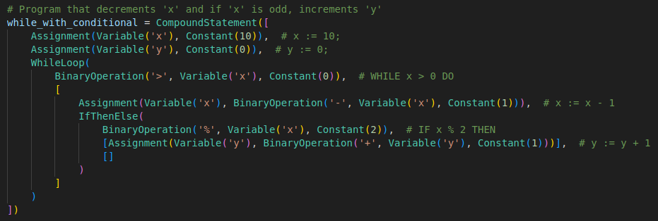
Program example

Slide 12
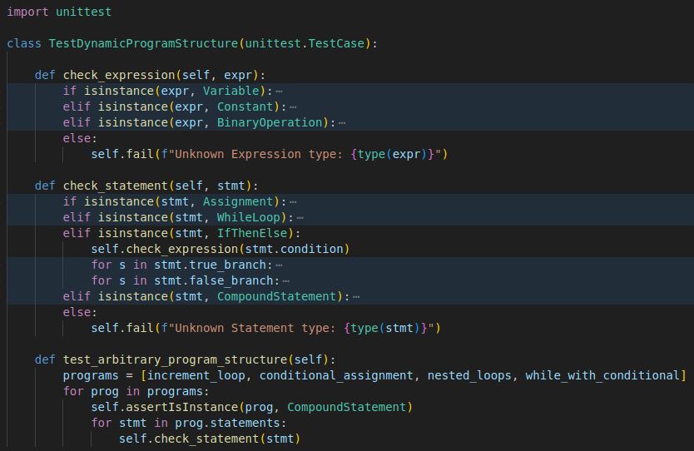
Testing the programs for consistency
The tree structure
of the syntax allowed
for a simple recursive
test case to validate
input programs
(not proper unit testing,
but does the job for
this project)

Slide 13
Superclass for a given analysis
Requirement: superclass for any given data flow analysis implementation
Some things can be implemented in the superclass (init, initial node, final node, print_nodes)
Some things are unique to the specific analysis implemented (gen and kill functions, transfer function, merge, and analyze)
Provided a useful overview of what’s needed for an analysis implementation

Slide 14
Reaching definitions implementation
Main part of the project (and the most challenging):
  What are we analysing here?
    Definitons (or, more correctly, assignments)
  What do the kill and gen functions do?
    A variable is generated when it is assigned
    And killed when it is reassigned
  What happens from from entry to exit?
    The statement in the node is analyzed
    Information/state is transferred/propagated
    from a node to the next

Slide 15
The analysis process
Recursive operations on each Statement of the program (as well
as their Expressions, when needed)
The analysis process:
  1. Using a properly formatted program as input (after validating)
  2. Creating nodes and CFG (for iterating over during analysis)
  3. Doing the analysis (transfer function and merge/intersection applied)*
  4. Printing the results
  *Some issues with making the Reaching Definitions analysis work, but this was later fixed by implementing an (almost) working Available Expressions solution

Slide 16
In retrospect (last slide)
Lessons learned/Retrospective:
Hard to implement an analysis while still trying to grasp it
Many recursive calls can be difficult to reason about
Turning abstract math into code can be tricky
With a little more time, the Available Expressions analysis would likely give a correct output

Slide 17
Demo

